Slide 1


DEVELOPING AN AI-POWERED TRACKING TOOL to IMPROVE TRACKING OF Diversity Supplement awardees throughout their careers September 21st, 2022
Stephanie Davis, Ph.D.
Samson Gebreab, Ph.D.
Christian Gomez, Ph.D.
Thomas Houze, Ph.D., M.Sc., M.B.A.
Melissa Smarr, Ph.D.

Slide 2

Background
The NIH awards administrative supplements to current grantees to enhance the diversity of the future biomedical workforce
PA-21-071 (Parent Program)
PA-21-345 (SBIR/STTR Program)
NIH staff may request information to evaluate program success
Metrics used to evaluate success
Employment
Peer-reviewed publications
Honors and awards
Research funding
Professional Development activities
Entrepreneurial activities (SBIR/STTR only)

Slide 3

The problem
Program staff heavily rely on eRA commons and various IMPAC II modules (i.e., QVR) to track awardee outcomes
Award is made to the PI, not the candidate
Several outcomes may not be found in the IMPAC II system
Information may be manually gleaned from social media accounts
Process may be time-consuming and tedious
Many diversity supplement awardees are “dropped” from the system when they choose non-academic careers

Slide 4

The proposed solution
“Web crawlers” are tools that continuously browse the world-wide web and gather information
May be used to create customized databases and events and update existing info
We propose using web crawlers to develop a database system to manage information about past and present Diversity Supplement candidates to achieve the following goals
Track long-term successful outcomes
Determine the ROI for diversity supplement programs
Receive feedback on how to improve programs

Slide 5
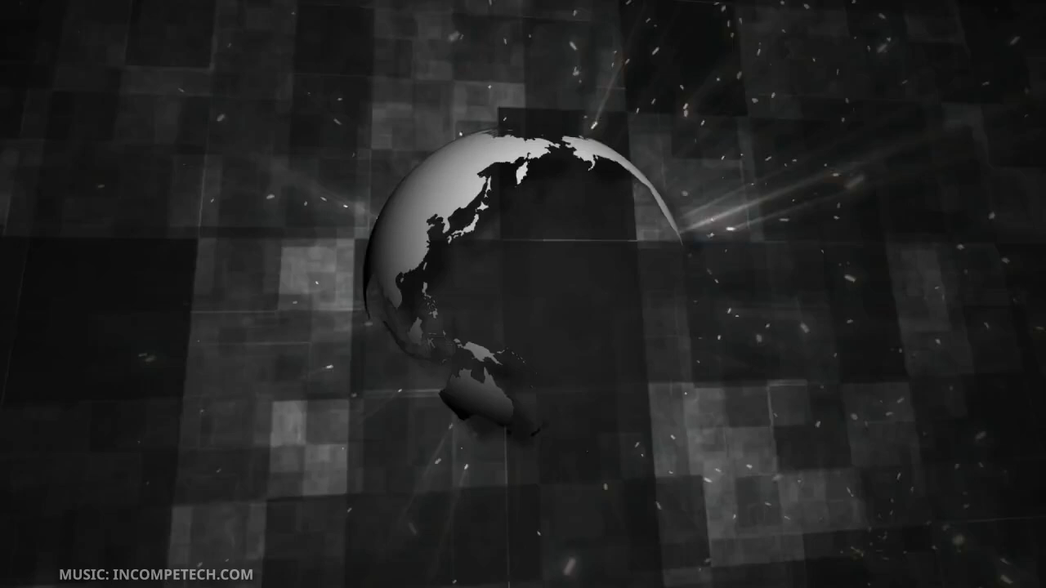
HOW WEB CRAWLERS WORK

Slide 6

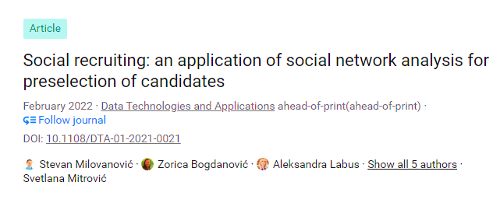




Web CRAWLERS HAVE BEEN USED TO TRACK CAREER OUTCOMES

Slide 7
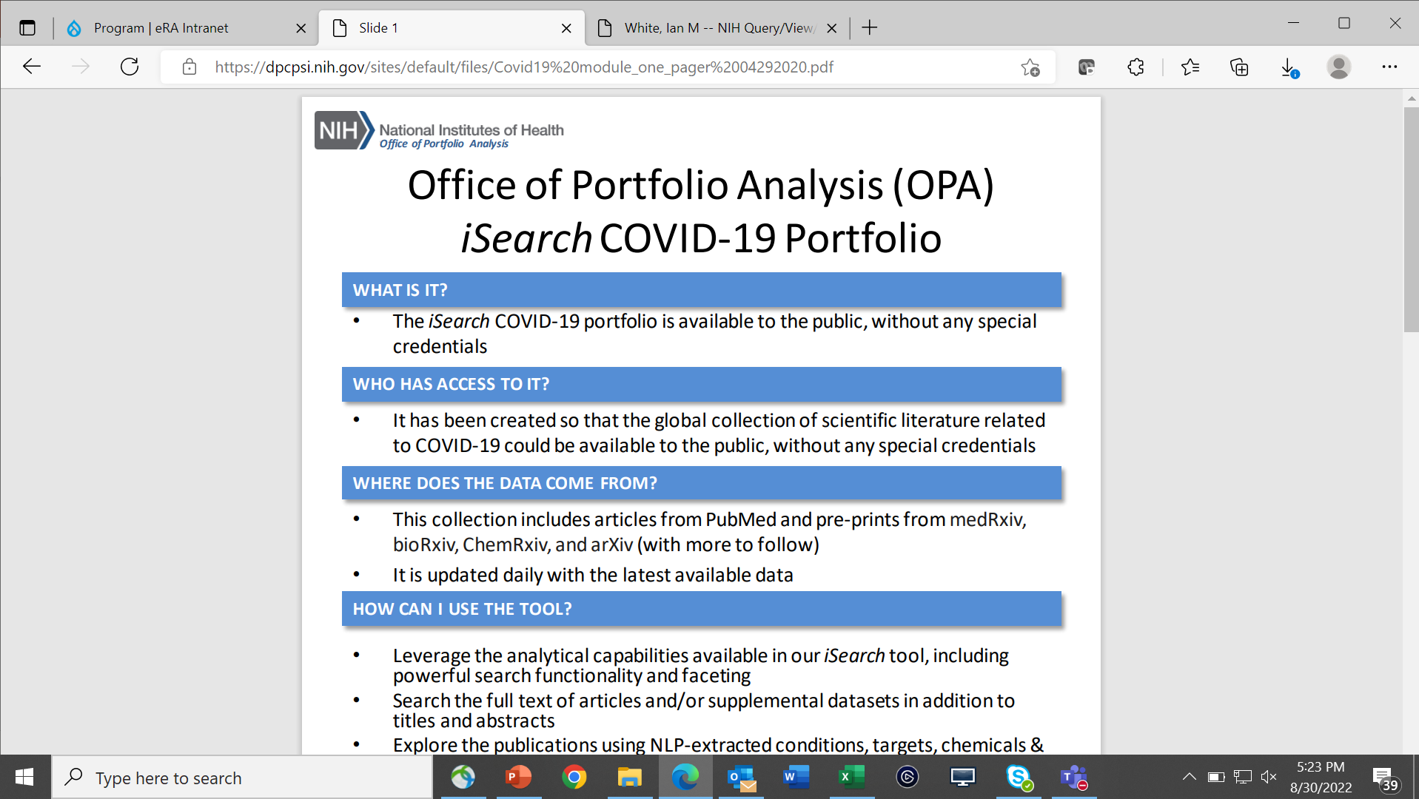
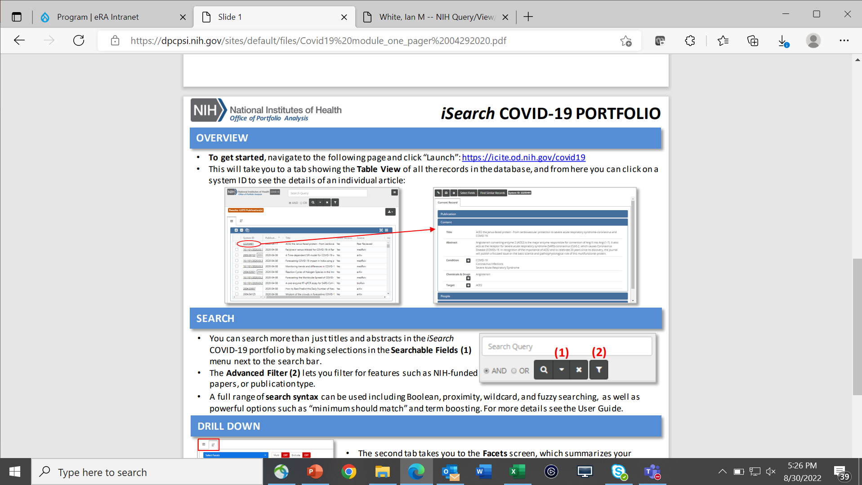
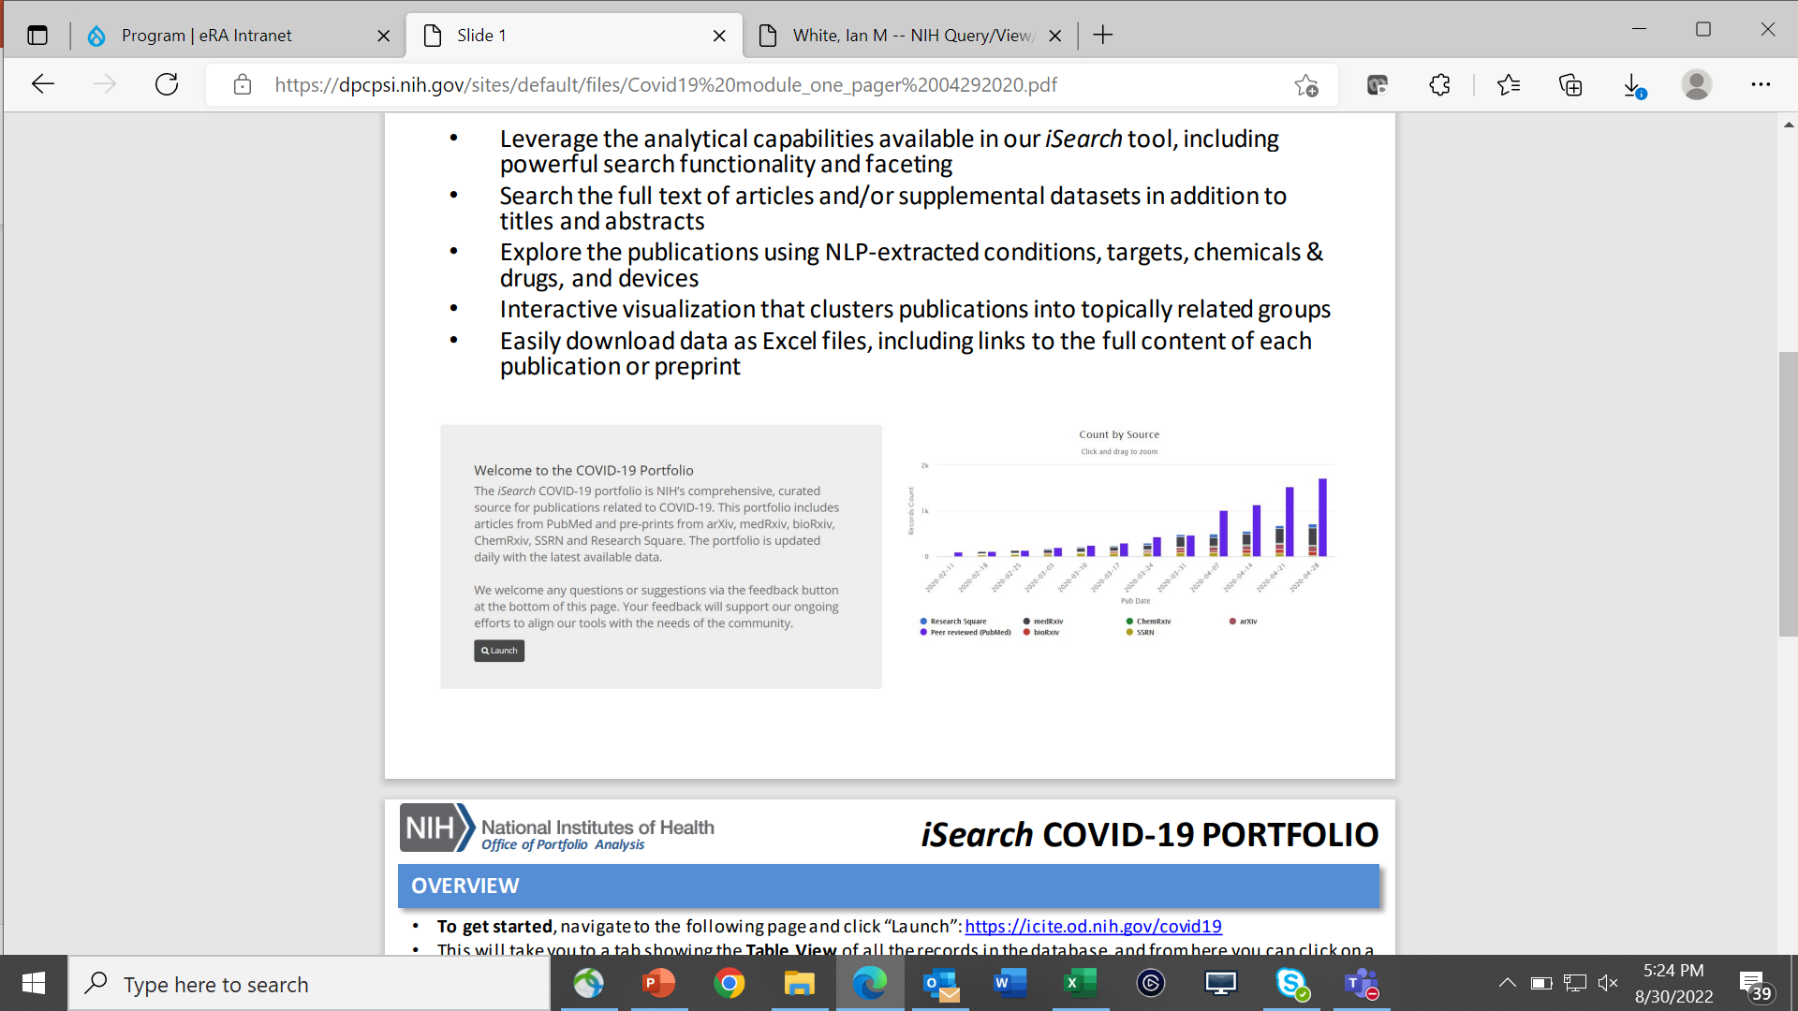
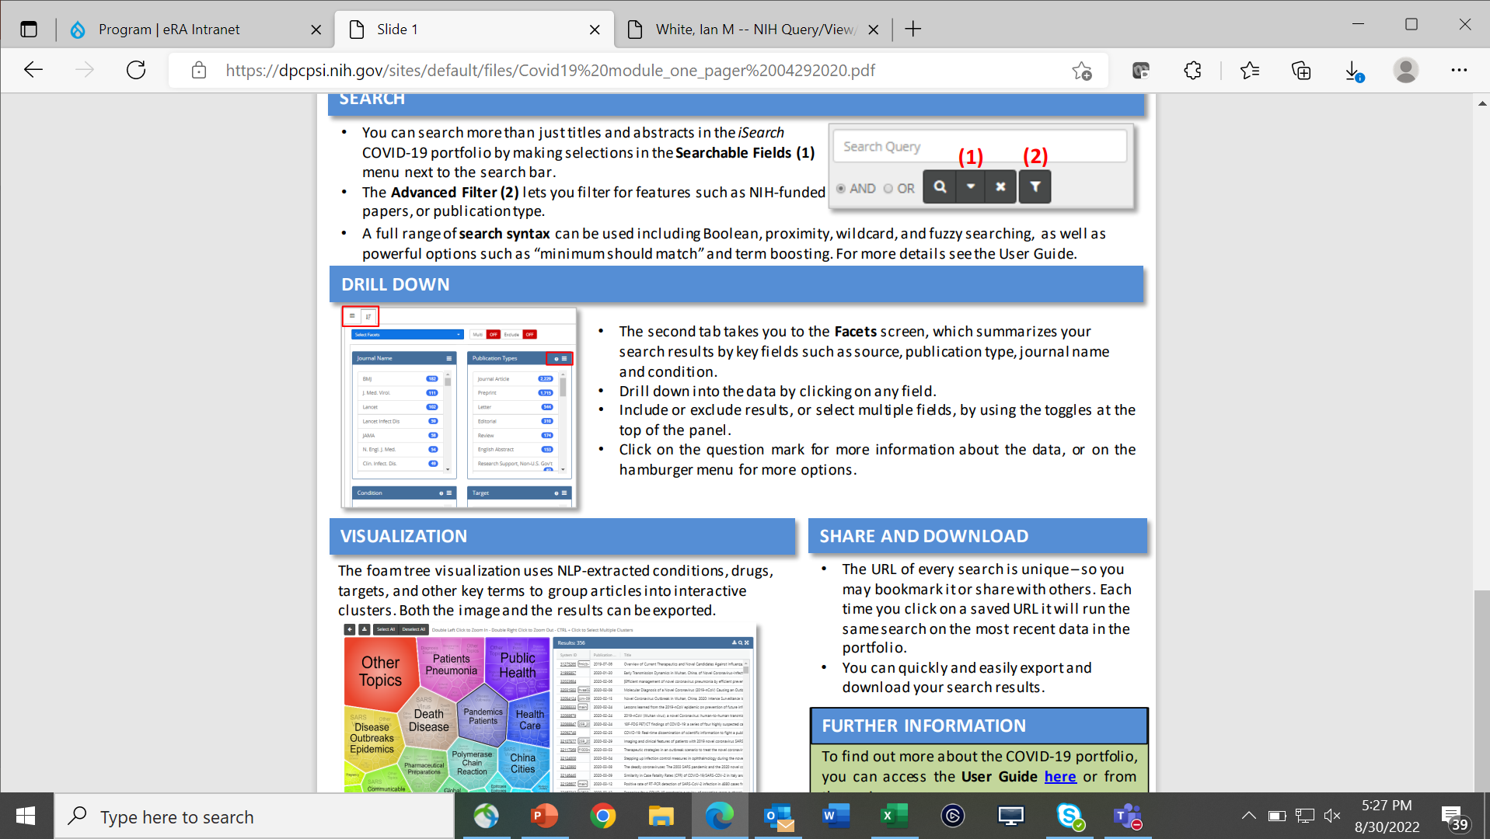
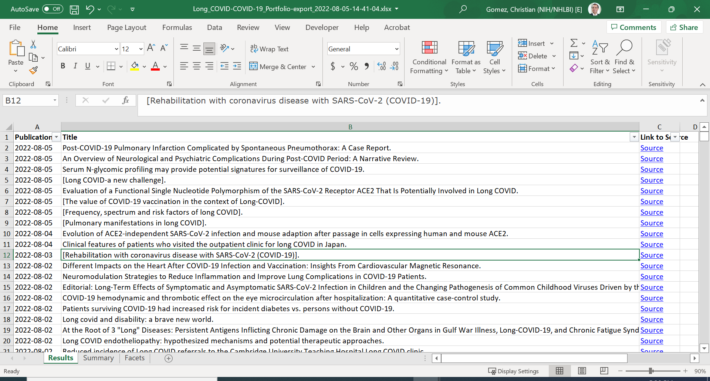
Web CRAWLERS ARE CURRENTLY BEING USED AT NIH

Slide 8
Hypothesis
The enhancement of the IMPAC-2 database by the use of a Custom Web Crawler will improve the retrieval of outcome data for past diversity supplement recipients compared to the current use of IMPAC-2
We propose the casting of a much broader net than can be accessed with the current means used to access the pool of underrepresented applicants than is allowed by the current methodology, which is limited to those applicants who are currently receiving funding or who have previously received Institutional funding

Slide 9

Benefits
Ability to gather up-to-date information on candidates who are no longer receiving NIH funding and thereby not being tracked by the IMPAC II database
Improve outreach to past candidates
Web crawlers are capable of continuously gathering data from institutional websites, social media pages such as LinkedIn, and other sites
Many web crawler tools are free and may be upgraded at a low licensing fee
The webcrawler is a supervised AI-enabled algorithm whose accuracy and performance improves over time

Slide 10

CHALLENGES
The NIH will need to spend time and money on implementing this new system
Which will require the commitment of FTE resources
Software licensing fees
Possible consultation cost even if OPA can be a resource
And there will naturally be a learning curve associated with the implementation of the webcrawler technology

Slide 11

LIMITATIONS
The cleaning of the metadata collected will be necessary
Software customization may be required for complex data acquisition projects
The retrieved data may be seasonal in nature
The webcrawlers may not be able to access certain websites due to IP blocking software (minor problem)

Slide 12
Responsible stakeholders
NIH Institutes and Centers
Program Officers
Chief Officer for Scientific Workforce Diversity
Office of Portfolio Analysis
Office of Data Science Strategy
Past and Present Diversity Supplement Candidates
Academic Institutions

Slide 13

Resources needed
OMB Clearance may not be required for a pilot study
A Data Repository
Personnel
Advisors/Consultants
FTEs
Interns
The Summer Graduate Data Science Program might be a suitable resource
Programming Language (Python is recommended)
Security and Maintenance (CIT)

Slide 14

SHORT-TERM Metrics for evaluation
The change in the % of tracked candidates who are in non-academic sectors compared to those tracked using NIH systems alone (IMPAC II, CareerTrac, xTrain, etc.)
The change in the number of personnel hours devoted to the tracking process per year
The creation of a new database in conjunction with OPA and CIT using data indexed by the web crawlers
Robustness of web crawler
The quality and the relevance of the results

Slide 15

LONG-TERM METRICS FOR EVALUATION
Improved outreach to past candidates who have been supported through diversity supplements
Increase in percentage of diverse scientists in total pool
Enhanced existing NIH efforts to strengthen diversity of scientific workforce
Increased percentage of URM scientists participating training & funding programs
Increased number of partnerships with diverse talent organizations & institutions
Expanded number of URM scientists who serve the NIH in various roles
Study section reviewers
Workshop speakers
Advisory council members
Notes:
Ultimately we hope that this will also improve our outreach to past awardees

Slide 16
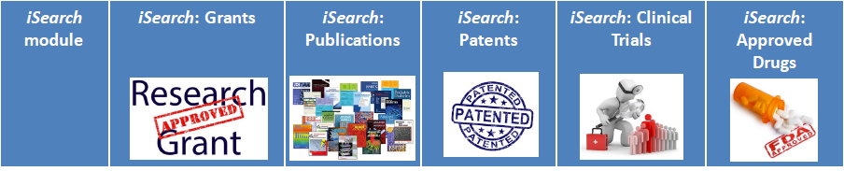

End goal
iSearch: Diversity Supplements
A web-crawler-based tool that can enhance the data available to OPA suite of tools by casting a wider net to capture more applicants and thereby to better enable the tracking of candidate outcomes and maximize the ROI for the Diversity Supplement Program

Slide 17

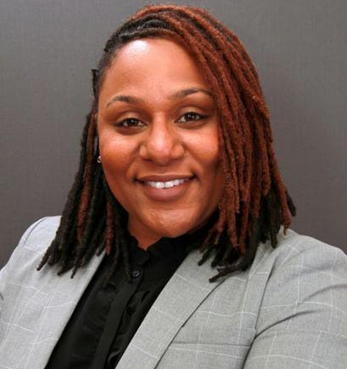



Thank you!
We would like to acknowledge the following individuals for shaping our proposal:
Wilson Compton
Todd Haim
Matt Perkins (OPA)

